Slide 1

ARGUMENTATIVE WRITING

Slide 2
ARGUMENTATIVE ESSAY
The argumentative essay
is a genre of writing that requires you to:
1. investigate a topic;
2. collect, generate, and evaluate evidence; and
3. establish a position on the topic in a concise manner.

Slide 3

Everyday Life Example
When we argue:
Bob: That was a lame movie!
Suzy: Why?
Bob: The special effects were bad. The monsters were obviously fake.
Suzy: I thought the movie was good because the acting was believable.
Bob’s bad response: You are an idiot.
Bob’s good response: Yes the acting was good but the horrible special effects were too distracting and caused some awkward moments.
Claim
Evidence
Counterclaim
Refutation

Slide 4

PERSUASION versus ARGUMENTATION
Persuasion: The action or fact of persuading someone or of being persuaded to do or believe something.
Argumentation: The process of establishing a claim and then proving it with the use of logical reasoning, examples, and research.

Slide 5
Difference between
Persuasive and Argumentative Essay
A persuasive essay
May make a claim based on opinion
May not take opposing ideas into account
Persuades by appealing to the audience’s emotion or by relying on the character or credentials of the writer
Emotion-based
An argumentative essay
Makes claims based on factual evidence (research)
Makes counterclaims – the author takes opposing views into account.
Neutralizes or “defeats” serious opposing ideas
Convinces audience through the merit and rationality of the claim and proofs offered
Logic-based

Slide 6
KEY TERMS TO LEARN BEFORE WRITING AN ARGUMENTATIVE ESSAY
1. Argumentation: the act or process of forming reasons, drawing conclusions, and applying them to a case in discussion.
2. Pro Argument (PRO): point or statement that supports one’s ideas.
3. Counter Argument (CON): point or statement in opposition to the argument being made in a written document or speech.
4. Refutation: the process of disproving an opposing argument.
5. Opponent: a person who disagrees with something and speaks against it.
6. Proponent: someone who argues in favor of something; advocate.

Slide 7

Elements of Argumentation
Argument/Claim
An argument states a claim and supports it with reasons and evidence from sources.
Arguing your side makes you the proponent.

Slide 8
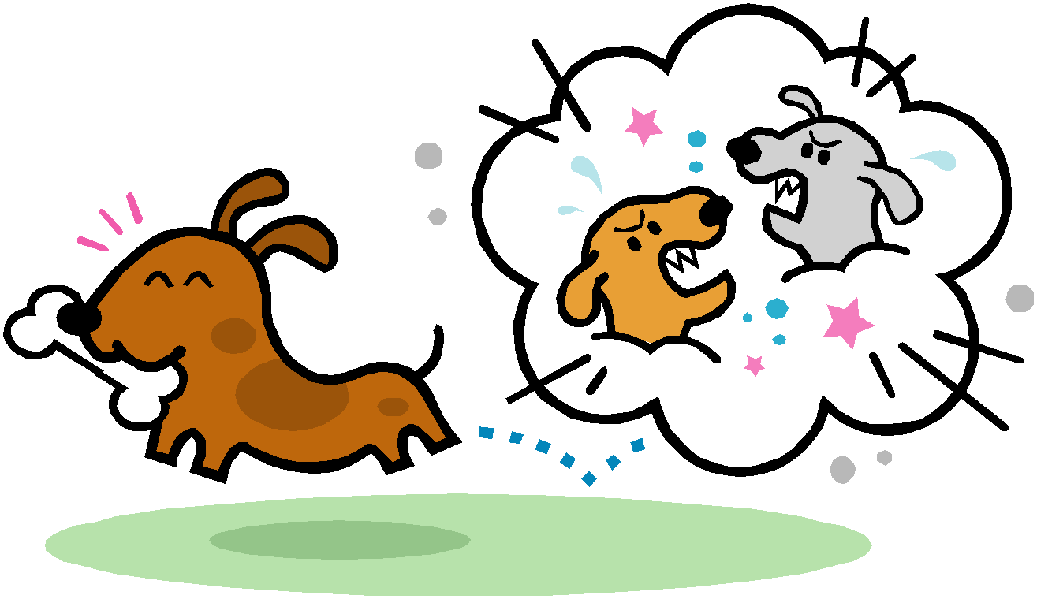
Elements of Argumentation
Counterargument/Counterclaim
An argument that stands in opposition to your argument/claim. The counterargument is your opponent’s (the other side’s) argument that tries to explains why you are wrong.

Slide 9

Elements of Argumentation
Refutation
Simply disproving an opposing argument. It is an important skill because it is how a writer successfully convinces the audience of the validity of his/her own argument.

Slide 10
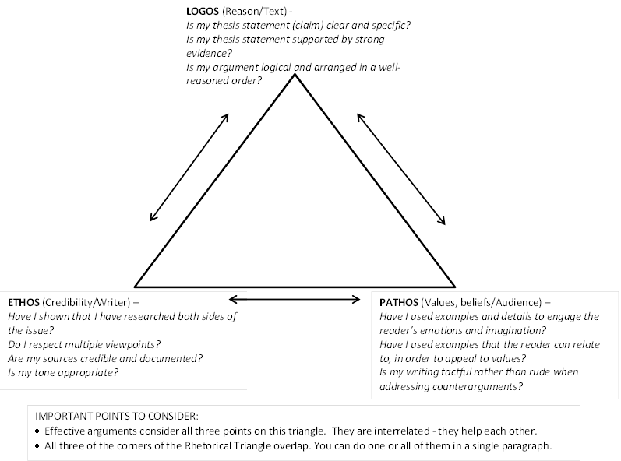
The Rhetorical Triangle – remember me?
Don’t forget to incorporate elements of ethos, pathos, and logos.

Slide 11
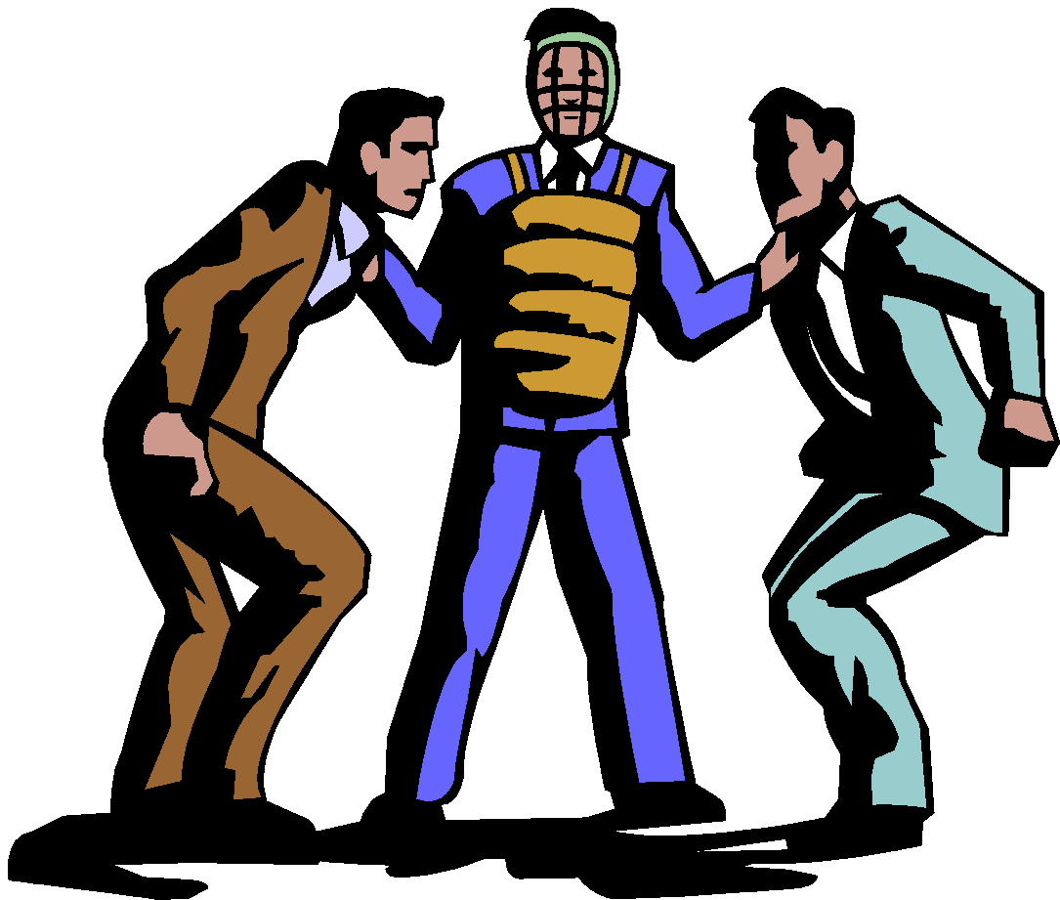
Why is Organization Important in Argument Writing?
Guides an audience through your reasoning process
Offers a clear explanation of each argued point
Demonstrates the credibility of the writer

Slide 12
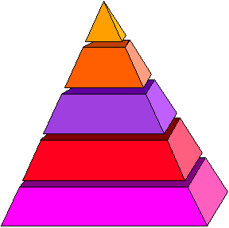
Organizing Your Argument
Introduction
Thesis statement
Body Paragraphs
Constructing Topic Sentences
Building Main Points
Countering the Opposition
Conclusion

Slide 13
What is an Introduction?
Acquaints the reader with the topic and purpose of the paper
Generates the audience’s interest in the topic
Offers a plan for the ensuing argument:
Introduction: Tell them what you’re going to tell them
Body: Tell them
Conclusion: Tell them what you told them

Slide 14

Methods for Constructing an Introduction
personal anecdote
question
shocking statistics

Slide 15
What is a Thesis Statement?
The MOST IMPORTANT SENTENCE in your paper
Lets the reader know the main idea of the paper
Answers the question: “What am I trying to prove?”
Not a factual statement, but a claim that has to be proven throughout the paper

Slide 16
TIME TO PRACTICE!
ARG.
1. ________ Censorship is the best way of controlling the minds of the citizens.
2. ________ Newspapers should not identify victims of sexual assault without their consent.
3. ________ Parents control their children’s TV viewing habits in three ways.
4. ________ In war journalism, it is never appropriate to show on the news how a country’s soldiers suffer in combat.
5. ________ The only way to receive high ratings for a TV series is to cast attractive actors or actresses.
ARG.
INF.
ARG.
ARG.

Slide 17
TIME TO PRACTICE!
INF.
6. ________ There are common practices that advertisers use to sell products.
7. ________ Politicians use various strategies to influence the media during their election campaigns.
8. ________ There are two main ways of manipulation in print media; false balancing, which means focusing on only one side of an argument; and slighting of the content, which aims at giving so much emphasis to style and so little to the actual substance.
INF.
INF.

Slide 18
TIME TO PRACTICE!
Choose two of the topics, and write an argumentative thesis statement for each.
1. war journalism
2. advertisements / commercials
3. reality programs
4. radio programs
5. the government
6. newspapers

Slide 19

Body Paragraphs and Topic Sentences
Body paragraphs build upon the claims made in the introductory paragraph(s).
Organize with the use of topic sentences that illustrate the main idea of each paragraph.
Offering a brief explanation of the history or recent developments of topic within the early body paragraphs can help the audience to become familiarized with your topic and the complexity of the issue.

Slide 20
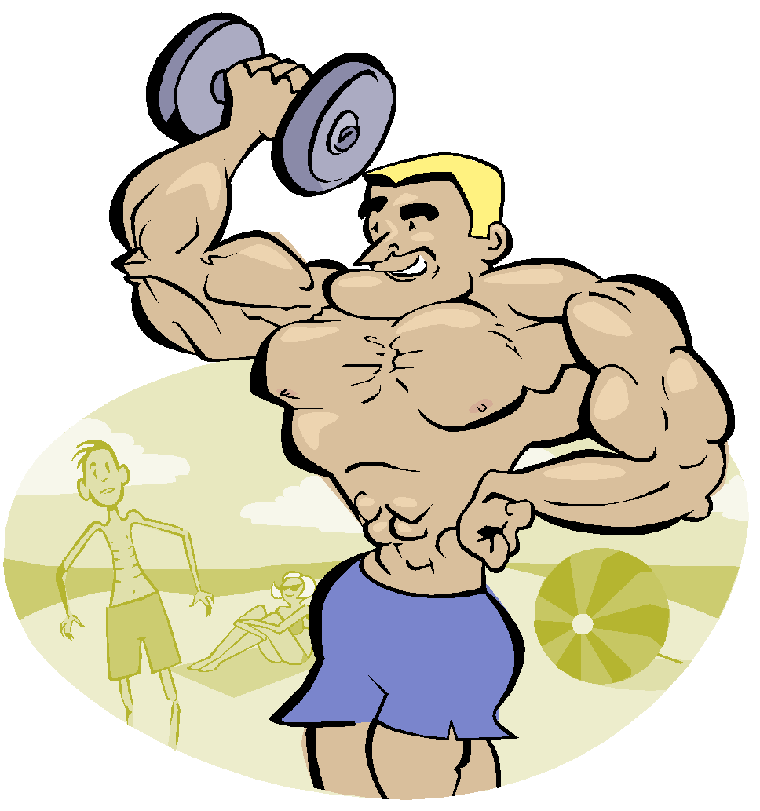
Body Paragraphs
Paragraphs may be ordered in several ways, depending upon the topic and purpose of your argument:
General to specific information
Most important point to least important point
Weakest claim to strongest claim

Slide 21
Offering a Counterargument
Addressing the claims of the opposition is an important component in building a convincing argument.
It demonstrates your credibility as a writer – you have researched multiple sides of the argument and have come to an informed decision.
It shows you have considered other points of view – that other points of view are valid and reasonable.

Slide 22
Effective Counterarguments
Consider your audience when you address the counterargument.
Conceding to some of your opposition’s concerns can demonstrate respect for their opinions.
Remain tactful yet firm.
Using rude or deprecating language can cause your audience to reject your position without carefully considering your claims.

Slide 23
Placement of a Counterargument
Counterarguments may be located at various locations within your body paragraphs.
You may choose to:
build each of your main points as a contrast to oppositional claims.
offer a counterargument after you have articulated your main claims.

Slide 24
Research in Body Paragraphs
Researched material can aid you in proving the claims of your argument and disproving oppositional claims.
Be sure to use your research to support the claims made in your topic sentences – make your research work to prove your argument.

Slide 25
Conclusion
Your conclusion should reemphasize the main points made in your paper.
You may choose to reiterate a call to action or speculate on the future of your topic, when appropriate.
Avoid raising new claims in your conclusion.
Introduction: Tell them what you’re going to tell them
Body: Tell them
Conclusion: Tell them what you told them

Slide 26
Recap: Organizing Your Argument
Introduction
Thesis statement
Body Paragraphs
Constructing Topic Sentences
Building Main Points
Countering the Opposition
Conclusion

Slide 27
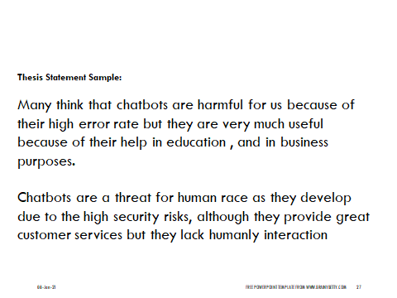

Slide 28
PRACTICE
Close Read the Model Argument Essay. While marking the text, specifically highlight the
Claim
Counterarguments/Counterclaims
Refutation
Does the conclusion meet the requirements? What changes, if any, would you make?

